Slide 1
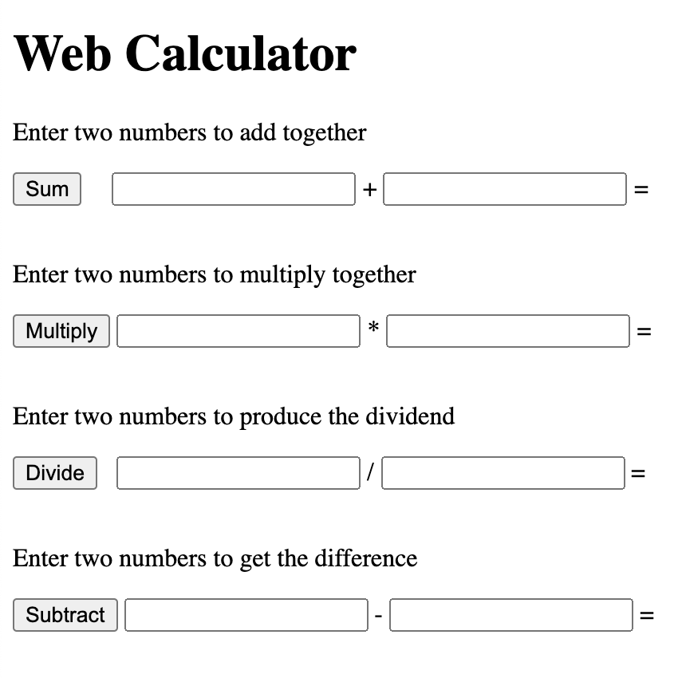
h1
Use the subsequent slide to draw shapes around the HTML elements needed to render this UI
When you select a shape icon, you can click the paint bucket and select transparent to just leave the outline.

Slide 2
div (heading)
div (addition)
p
div (multiplication)
body
div (division)
span
div (subtraction)
button
span

Slide 3

Use the subsequent slides to try this advance mock up reverse engineering exercise

